Slide 1
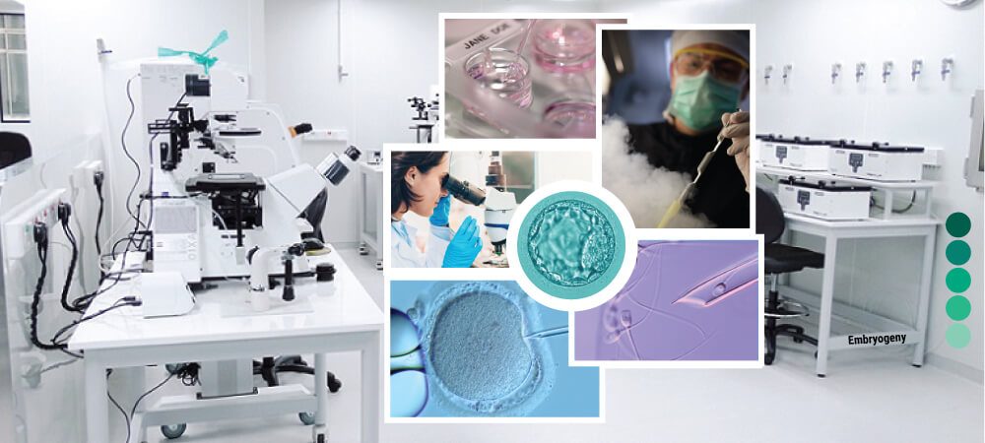


Optimized Equipment Utilization and Management for IVF Laboratory Operations

Slide 2
Contents
Business Objective
Business Constraints
Project Architecture - Data Flow Diagram
Data Collection
Exploratory Data Analysis
Data Visualization
Notes:
Change

Slide 3
Business Problem
IVF labs rely on high-cost equipment such as incubators, microscopes, and ICSI workstations, yet utilization rates vary widely (40-85%), leading to 20-30% idle time, 10-15% workflow delays, and 15-25% unnecessary operating costs. At the same time, insufficient redundancy for critical procedures can cause 2-4 hour delays when equipment is unavailable, directly affecting embryo viability and clinic throughput.

Slide 4
Project Overview and Scope
Project Overview:
This project analyzes how IVF lab equipment is used, focusing on utilization, idle time, downtime, and delays to find inefficiencies and improve lab performance.
Project Scope:
The project studies equipment capacity, usage, delays, and case volume using data analysis and dashboards to help optimize scheduling, reduce costs, and improve patient throughput.

Slide 5
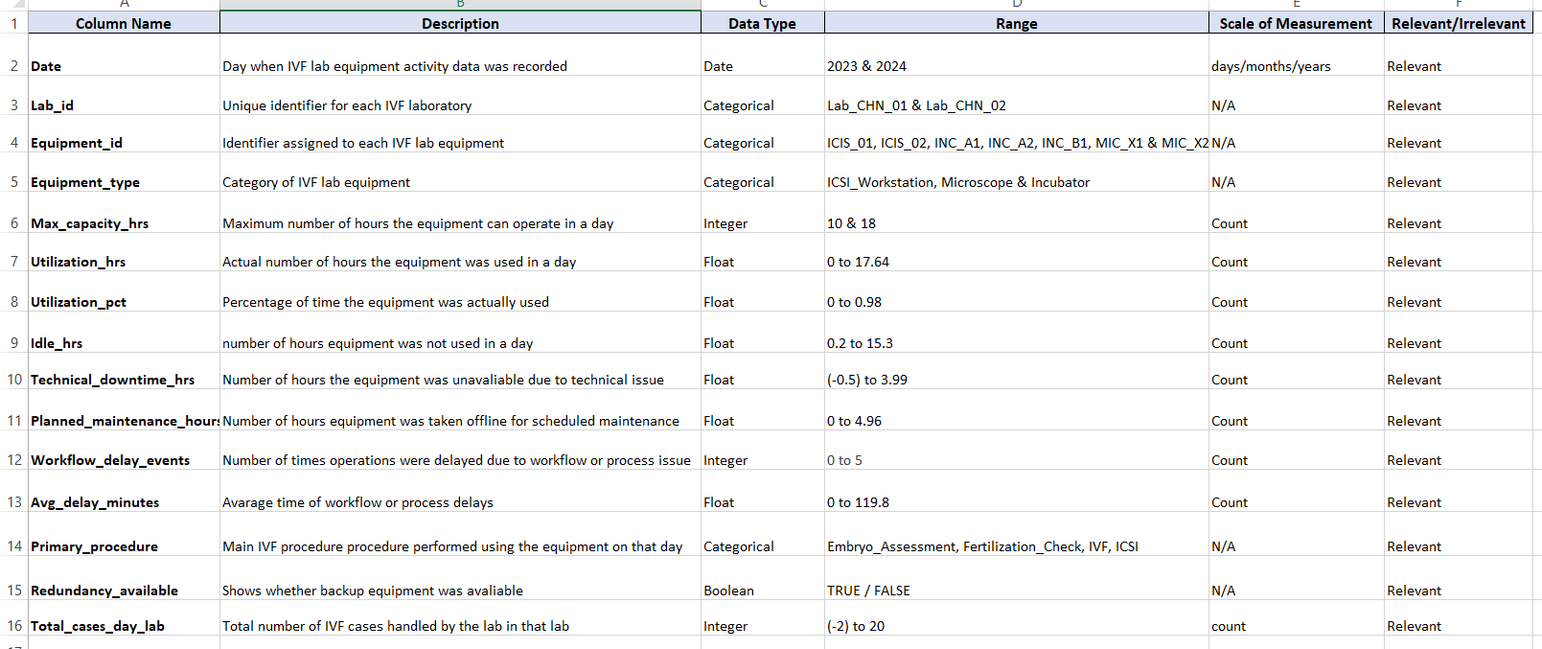
Data Dictionary

Slide 6
Exploratory Data Analysis [EDA]
Statistical Insights
Business Insights
1. How much equipment is actually used
2. How much time is wasted (idle & downtime)
3. Where delays and bottlenecks occur
4. Whether data is stable or risky
5. Which values are normal vs extreme
1. Most equipment is not used to its full capacity.
2. High idle time increases operating costs.
3. Many delays come from poor scheduling, not machine failure.
4. A few big breakdowns cause most disruptions.
5. More cases can be handled by using existing equipment better.
Notes:
EDA is used for seeing what the data can tell us before the modeling task.
Change

Slide 7
Data Preprocessing
Step 1 – Data Cleaning
Convert date to proper date format
Fix mixed date formats
Remove duplicate rows
Convert all hour and minute columns to numeric
Step 5 – Remove Redundancy
utilization_pct = utilization_hrs / max_capacity_hrs
→ Keep either percentage or hours to avoid duplication
Step 6 – Feature Engineering
Create new meaningful features:
Utilization Category (Low / Medium / High)
Idle %
Delay Severity
Equipment Efficiency %
Step 2 – Handle Missing ValuesDate → forward fill / backward fill
Utilization, idle, delays → replace with median or zero (based on business meaning)
Step 3 – Handle Zero-Heavy Columns
Identify columns with many zeros:
  technical_downtime_hrs
  planned_maintenance_hrs
  workflow_delay_events
  avg_delay_minutes
Create flags:
  Downtime_Flag
  Maintenance_Flag
  Delay_Flag
Step 7 – Scaling
Apply Min-Max or Standard scaling to numeric columns for modeling
Step 8 – Validation
Recheck missing values
Recheck outliers
Replot boxplots & histograms
Step 4 – Outlier Treatment
Apply IQR or percentile capping on:
  avg_delay_minutes
  technical_downtime_hrs
  planned_maintenance_hrs
  idle_hrs
Final Goal
Clean, reliable, and business-ready data for:
SQL analysis
Power BI dashboard
Predictive modeling
Notes:
Keep observations

Slide 8
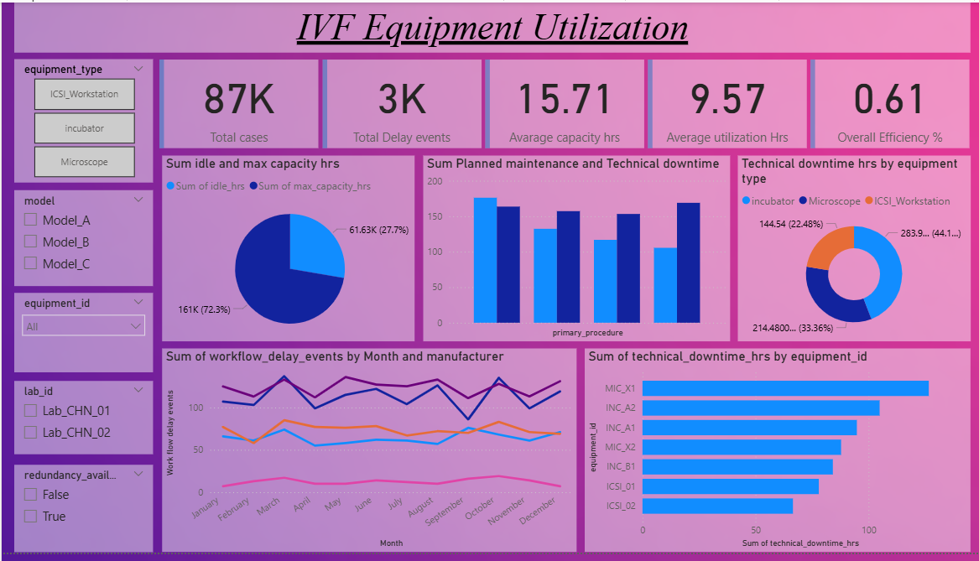
Data Visualization
Notes:
Add graphical

Slide 9


